Slide 1
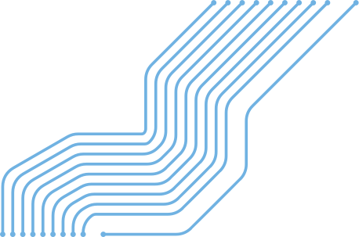

GIT

Slide 2
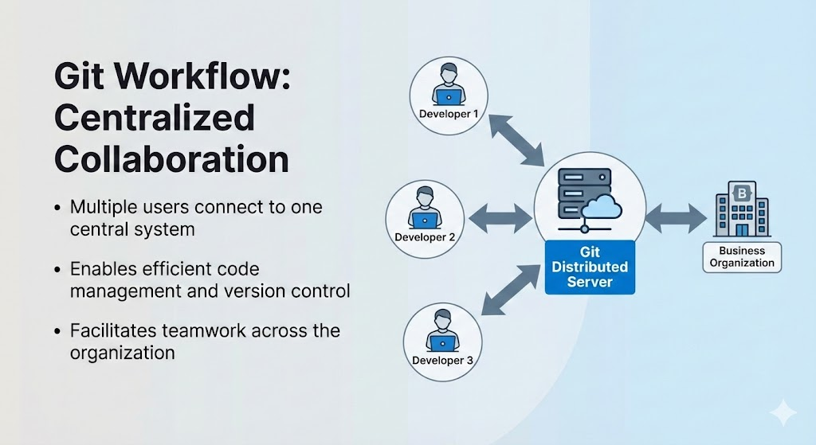
INTRODUCTION TO GIT
What is Git ?
A distributed version control system for tracking changes in computer files.
Primarily used for source code management (SCM) in software development.

Slide 3
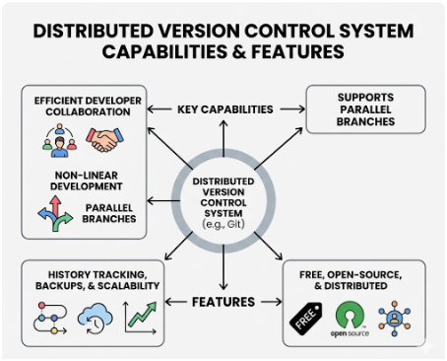
KEY CAPABILITIES:
Allows multiple developers to collaborate efficiently.
Supports non-linear development through parallel branches.
FEATURES:
Tracks history, creates backups, and is scalable.
Free, open-source, and distributed.

Slide 4
WHY USE VERSION CONTROL?
PURPOSE:
TRACKING:
Enables collaboration and creates a centralized location for code.
Streamlines development and helps resolve conflicts.
Tracks who made changes, what was changed, and when.
Prevents concurrent work from conflicting.

Slide 5

CORE BENEFITS:
Quality: Teams can review and improve each other's code.
Acceleration: Faster branching, merging, and changes.
Visibility: Better insight into release patterns and builds.

Slide 6
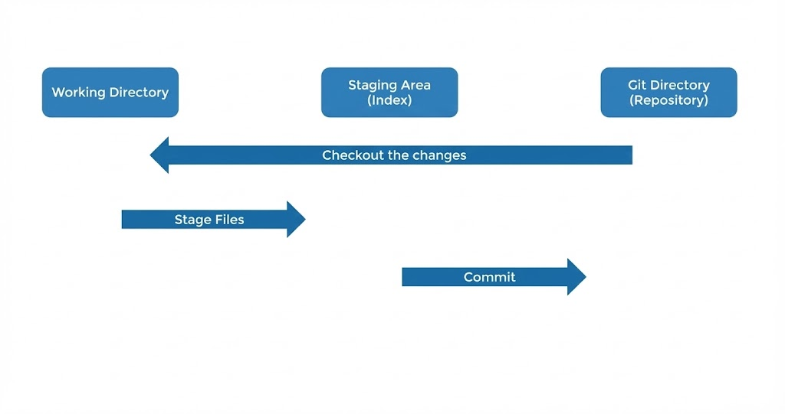
THE GIT WORKFLOW
THE THREE MAIN STATES:
Working Directory: Where you modify and edit your files.
Staging Area (Index): Where you organize snapshots of files before saving.
Git Directory (Repository): Where snapshots are permanently stored.
THE CYCLE:
Modify- Stage- Commit.

Slide 7
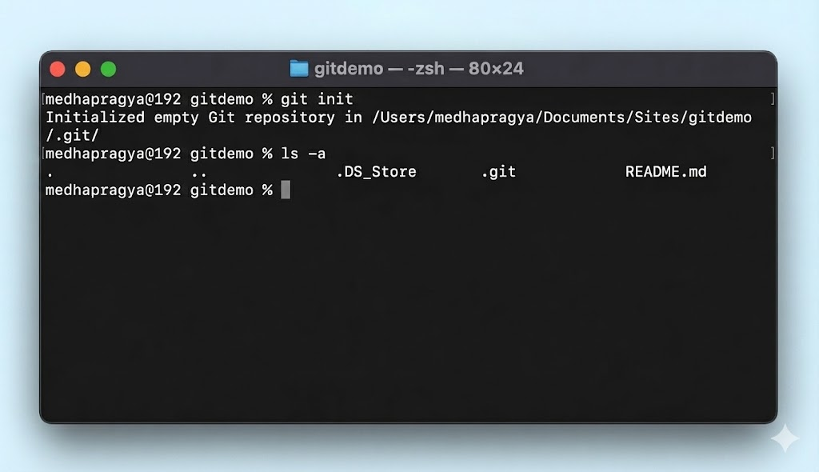
REPOSITORIES
THE CYCLE:
A .git folder inside your project that tracks all project history.
INITIALIZATION:
Command: git init.
Initializes a new repository in your current folder.
BEHIND THE SCENES:
The .git folder is hidden by default.
To View: Use the command ls -a in the terminal.

Slide 8
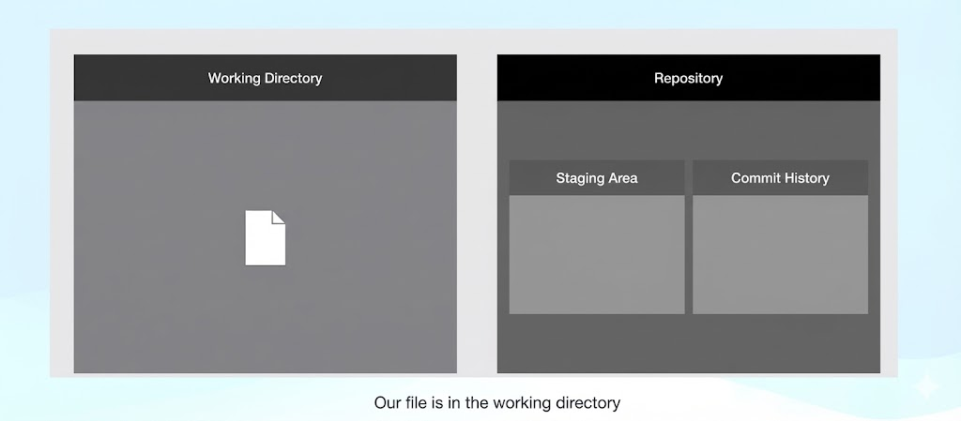
COMMIT IN GIT
Step 1 — Edit Files
Content:
Action: Create or modify a file in the Working Directory.
Check Status:
Command: git status.
Shows differences between the working directory and staging area.
Result:
New files appear as "Untracked"

Slide 9
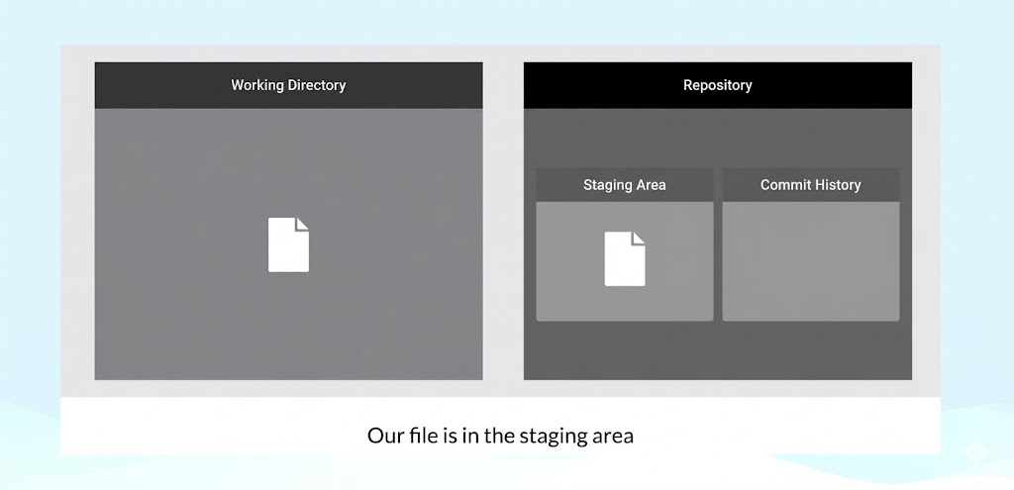
Step 2 — Add to Staging
Action: Move files from Working Directory to the Staging Area.
Command: git add <filename>.
Result:
1. File is ready to be included in the next commit.
2. git status now shows "Changes to be committed"

Slide 10

Step 3 — Make the Commit
Action: Permanently save the snapshot to the Repository.
Command: git commit -m "Message".
Verify History:
1. Command: git log.
2. Lists all commits in reverse chronological order.

Slide 11
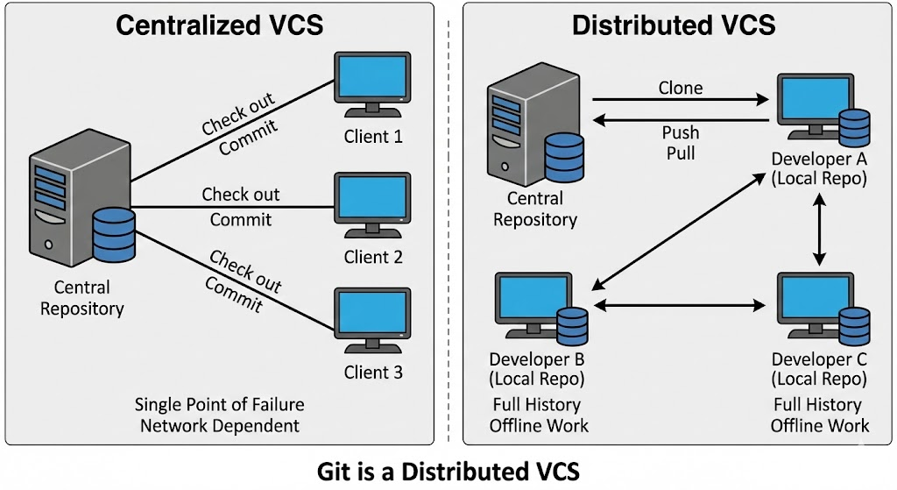
TYPES OF SOURCE CONTROL
Two Main Categories:
Centralized: One main server holds the data. If it fails, work stops.
Distributed (Git): Every developer has a full copy of the history.

Slide 12
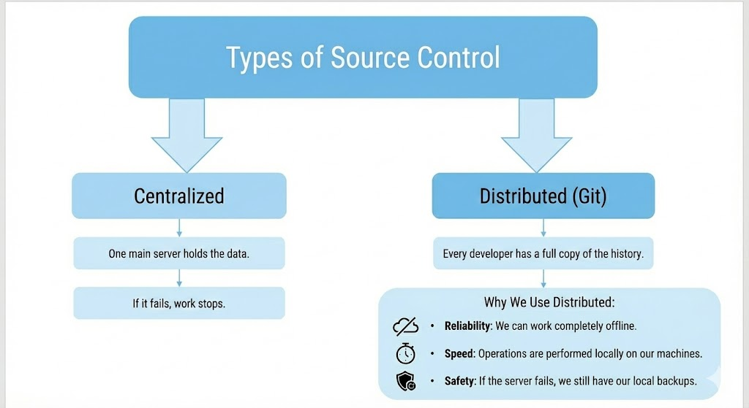
Why We Use Distributed:
Reliability: We can work completely offline.
Speed: Operations are performed locally on our machines.
Safety: If the server fails, we still have our local backups.

Slide 13
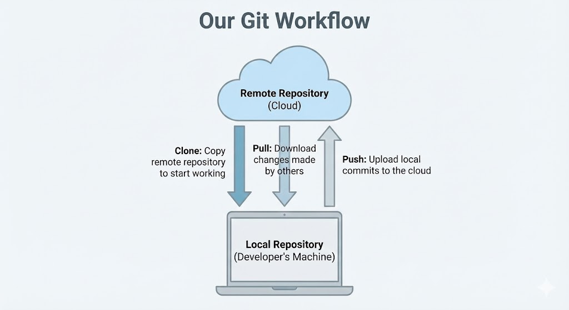
REMOTE REPOSITORIES
Remote Repositories:
Versions of our project hosted on the internet
Acts as the central hub for our team collaboration.
Our Workflow:
Push: We upload our local commits to the cloud.
Pull: We download changes made by others.
Clone: We copy a remote repository to start working.

Slide 14
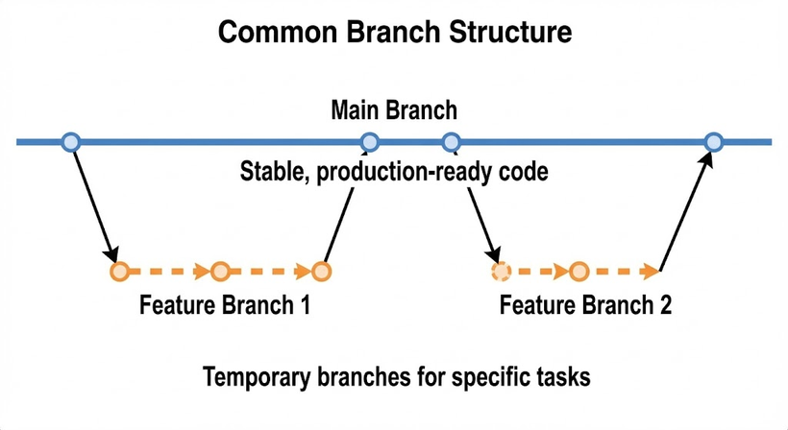
BRANCHING STRATEGIES
What is a Branch?
A parallel version of our code where we can work safely.
Why We Branch:
Isolation: We can fix bugs or add features without breaking the main code.
Code Review: We review changes on a branch before merging them.
Common Structure:
Main Branch: The stable, production-ready code.
Feature Branches: Temporary branches for our specific tasks.

Slide 15
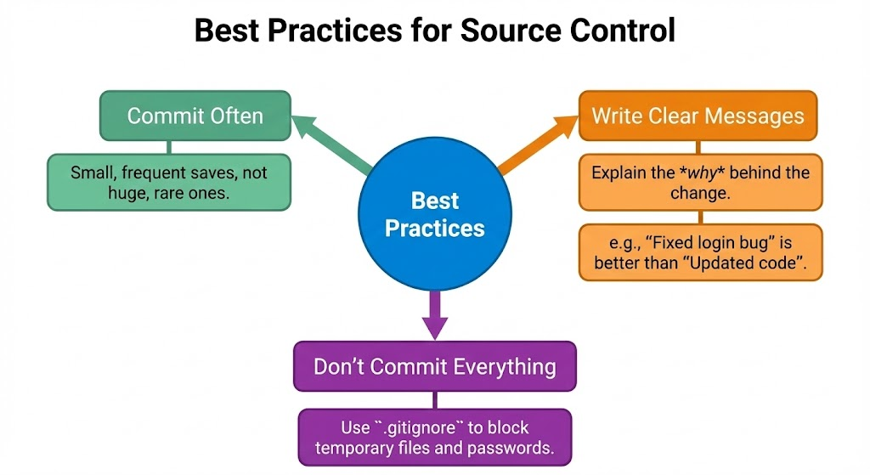
BEST PRACTICES
Commit Often:
Make small, frequent saves rather than huge, rare ones.
Write Clear Messages:
Explain why we made the change.
Don't Commit Everything:
Use .gitignore to block temporary files and passwords.

Slide 16
THANK YOU

